Slide 1
Covid-19 and the restaurant industry
Ellie Goodman

Slide 2
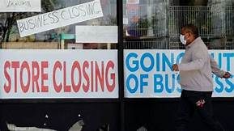
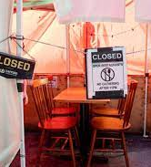
Our topic
- Covid-19 has affected everything in our lives
- Failing restaurant industry
Lack of goods
Loss of income
Businesses going out of business

Slide 3
Why is it important?
People losing jobs, income, stability
Economy is failing
Market segments and competitors cannot exist
Harder for restaurants to stay afloat
More than 10% of restaurants have completely gone out of business in the United States since the Pandemic started
Food services accounted for 1 in 4 jobs lost during the pandemic

Slide 4
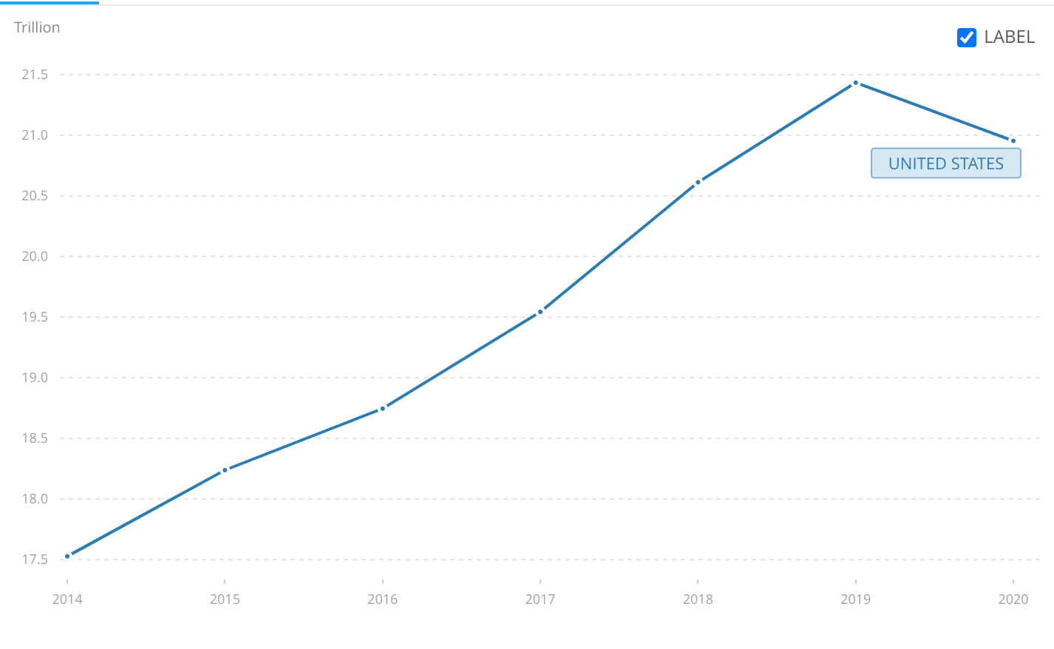
How has it affected our economy?
Restaurants Total Sales Revenue
Restaurant saw total sales for 2020 fall $240 Billion below pre pandemic projected sales
Total sales affect "Value of output"
Restaurant industry makes up about 4%
Total US GDP saw a decrease of half a trillion dollars in 2020
Worldbank.com
Notes:
While the pandemic has affected many individual restaurants, and changed the lives of their employees, there has also been a large scale affect on the entire restaurant industry which has had a significant impact on the US economy. The restaurant industry saw a large decrease in sales in the initial year of the pandemic. In 2020 total sales fell 240 billion dollars short of pre pandemic projected sales. Total sales are a function of "value output" which is a component of GDP. Given that restaurants make up about 4% of the US GDP this decrease in sales played a significant role in the half a trillion dollar decrease that the US saw in GDP from 2019 to 2020. GDP is an important way to measure the size and performance of an economy.

Slide 5
HOW HAS IT AFFECTED OUR ECONOMY?
Restaurants Unemployment Levels
Restaurant industry saw the highest peak of unemployment at 39%
Almost double the amount of unemployment as other industries as of 2/2022
Effects on GDP, Individuals, unemployment benefits paid, potential tax increases
Notes:
In addition to the restaurant industries decreased total sales which lead to a decreased GDP. The US economy saw a stark increase in its unemployment rates. Specifically, the restaurant industry was hit the hardest as it saw a peak unemployment rate of 39% in April 2020. While the industry has been making a steady recovery, it is still sitting at an unemployment rate of 8% which is about twice as high as other US industries as of February 2022. Higher unemployment rates mean many things for the US Economy. It can lead to lower GDP, the government having to pay out more unemployment benefits, as well as the government potentially raising taxes on businesses to make up for the tax collection lost from laid off employees. Not only does increased unemployment affect the economy as a whole but it also means that many laid off employees and their families will face financial struggles. Given the imporatnace of the restaurant industry not only for the economy but also for individuials, it is essential that we work towards helping the industry regain its pre pandemic position.

Slide 6
COVID-19 presented a need for Operational process shifts
Order to be Fulfilled
Host Stand Check-in / Wait for table
Place Order / be waited on
Prepare Order
Checkout
Traditional experience
Delivery/Carry-Out model
Order to be Fulfilled
Place order via phone, delivery app, or website - checkout
Prepare Order
Deliver or prepare for pickup
Notes:
Government regulation and consumers’ fears of contracting COVID-19 presented an immediate need for process flow change within the restaurant industry.
Process flow traditionally similar to the top path (explain)
Eating out was heavily service oriented/hands on with wait staff
Many restaurants in an effort to combat demand reduction had to think of new methods of bringing customers in.
Delivery/Carry out model that had been in place in the pizza industry was quickly adopted/innovated by places not traditionally associated.
Explain flow chart
Reduced need for service oriented staff, process was more hands off and more about the food rather than dining experience

Slide 7
Effects of the process shifts
Increased capacity for orders
Physical space of dining area no longer a limiter – only kitchen space/staff capabilities
Reduced need for service-oriented resources
Bare-bones operation of cooks and people able to handle order intake and packaging
Less employee idle time – all roles are directly related to food preparation and fulfillment
Lagging restaurants left in the dust
Notes:
Selom will talk about restaurants’ need to become flexible moving forward

Slide 8
Flexibility within the restaurant industry
Flexibility allows restaurant's limited staff due to the pandemic to be used effectively
A crucial example of flexibility would be to train employees for multiple roles to maximize usefulness and eliminate idle time

Slide 9
Operations within the restaurant industry
Operations management pushes individuals to do their jobs, not only that, but improve such job as well
To implement operation management, managers are required to face three system inhibitors which are:
Waste
Variability
Inflexibility

Slide 10
Sources
Gérard Cachon & Christian Terweisch, 2020 https://prod.reader-ui.prod.mheducation.com/epub/sn_5ffc2b/data-uuid-3ef3571dd2a549dbbf1f07ca8f6869bb#data-uuid0fc546398519491ab33a979695345415
Sharma, Amit. “Restaurants and Foodservice Businesses during COVID.” 19, 18 June 2020, https://covid19.ssri.psu.edu/articles/restaurants-and-foodservice-businesses-during-covid-19.
Kaufman, Michael. “Restaurant Revolution: How the Industry Is Fighting to Stay Alive.” Forbes, Forbes Magazine, 10 Aug. 2020, https://www.forbes.com/sites/hbsworkingknowledge/2020/08/10/restaurant-revolution-how-the-industry-is-fighting-to-stay-alive/?sh=59fadccdf1eb.
Stabley, Justin. “How Restaurants Have Innovated to Fact the Pandemic.” PBS News Hour, PBS, 14 Sep 2021, https://www.pbs.org/newshour/economy/how-restaurants-have-innovated-to-face-the-pandemic

